Slide 1
CIS 4930/6930-002 Data Visualization
Name that Channel!
Paul Rosen
Assistant Professor
University of South Florida
.

Slide 2
Instruction
With 1 or 2 partners, for the following visualizations, name:
Types of marks used (0D, 1D, 2D)
Types of data attribute (categorical, ordinal, or quantitative)
The visual encoding channels used (position, color, shape, etc.)

Slide 3
https://www.visualcapitalist.com/20-internet-giants-rule-web/

Slide 4
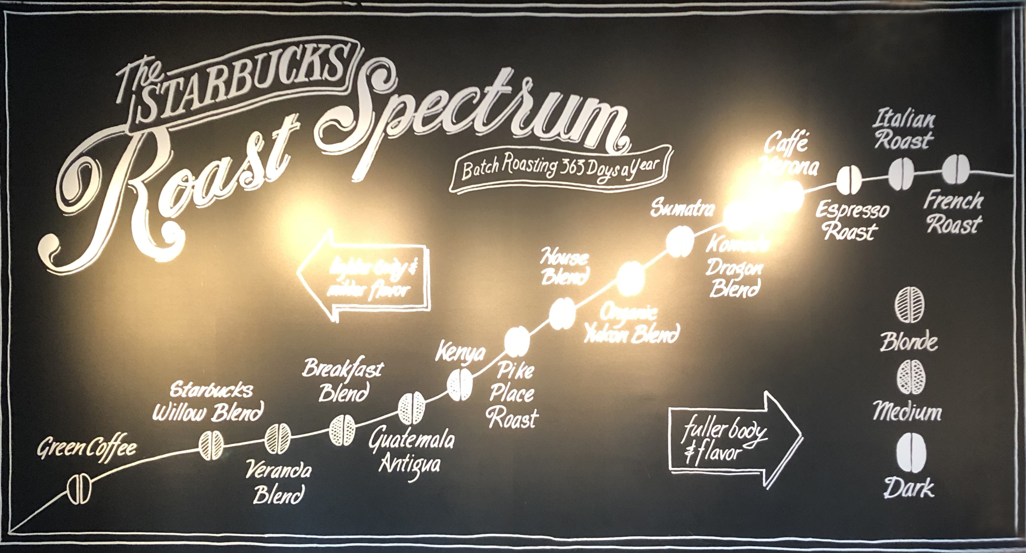
Credit: Starbucks

Slide 5
Types of marks used (0D, 1D, 2D)
Types of data attribute (categorical, ordinal, or quantitative)
The visual encoding channels used (position, color, shape, etc.)

